Slide 1
Task Tracker
By: Adiyar Kaidaruly, Adam Barber

Slide 2
Description
Keep track of what you need to do
Help yourself stay consistent
Set reminders so you never forget
Use the timer so stay on time

Slide 3
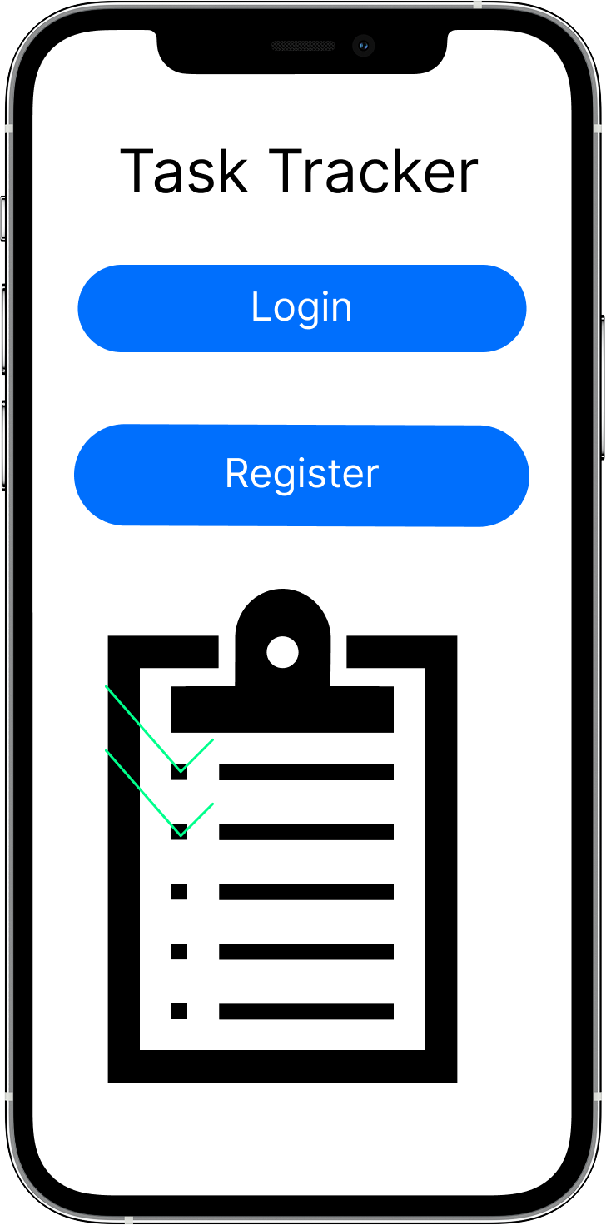
Homepage
This is the Homepage of our app. It only has two buttons one for logging into to the app if you already have an account and another button for registration if you don’t have an account.

Slide 4
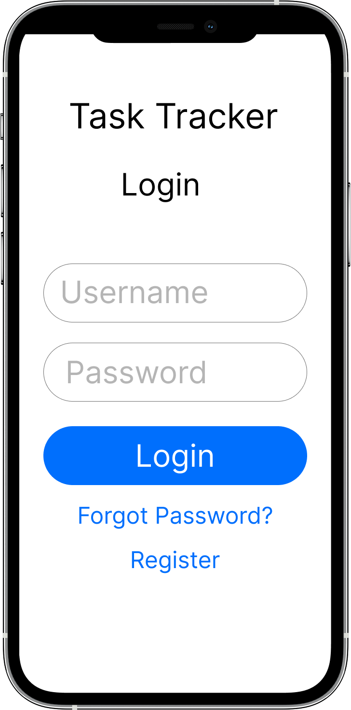
Login
The login screen includes fields for username and password, along with a login button.
Below the login button there are two links, Forgot Password which will take you to the password reset page and Register which takes you to the registration page.

Slide 5
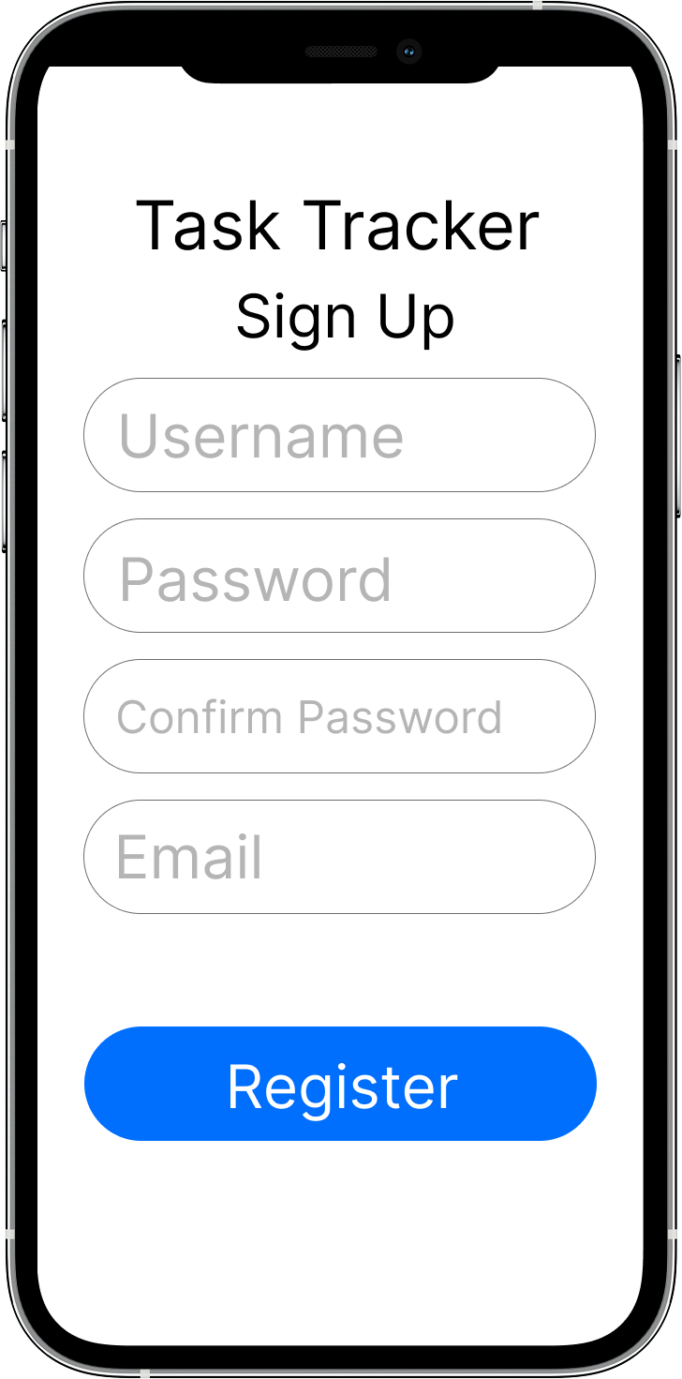
Registration
The registration screen which lets new users create an account by providing a username, password, and email. This information is stored in a database for login later.

Slide 6
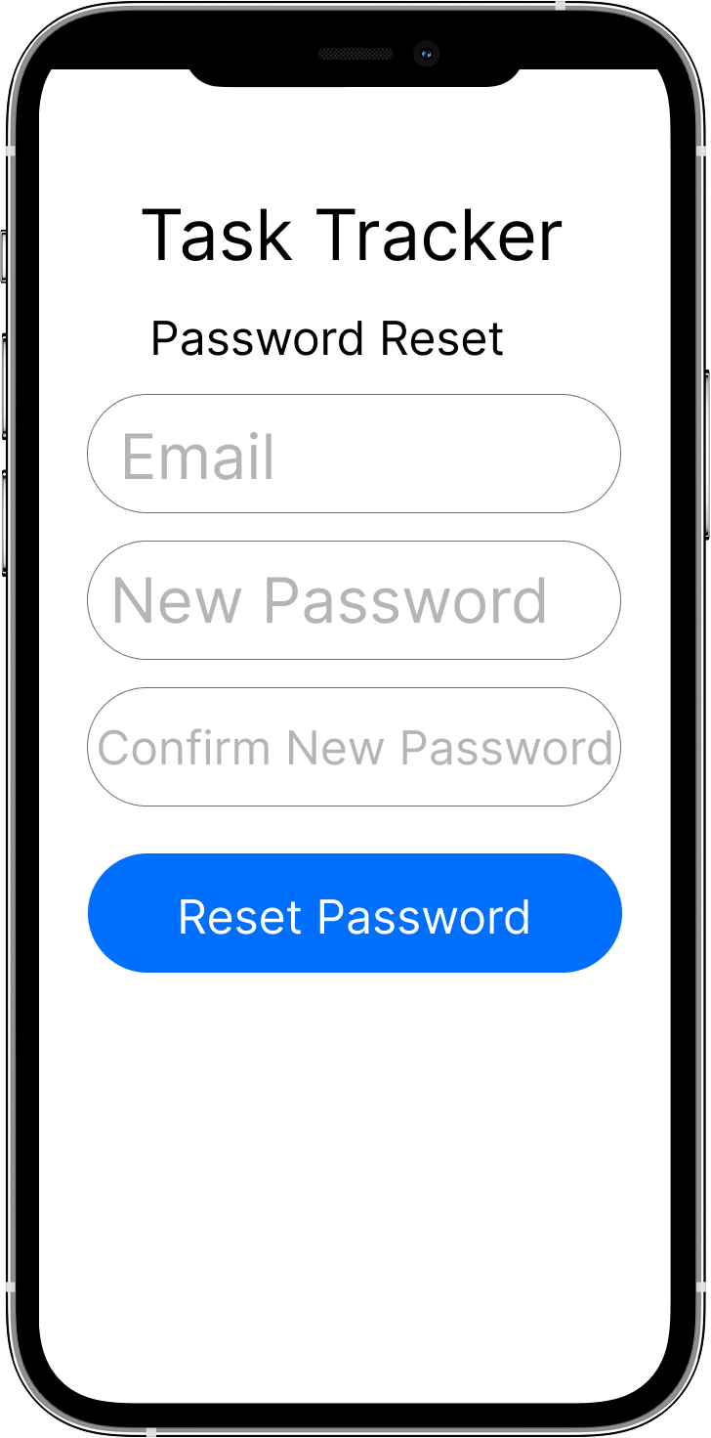
Password Reset
If a user forgets their password, they can come here and enter their email along with the new desired password and click reset password which will send an email to the user.

Slide 7
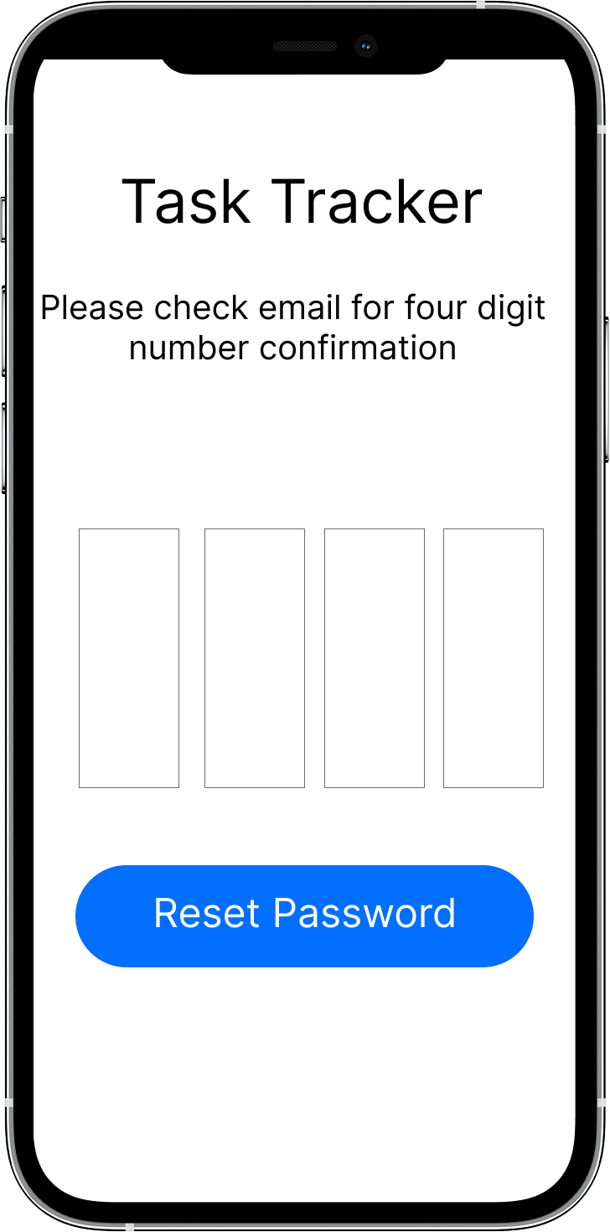
Password Reset #2
Afterwards the user will be redirected to this page where it tells the user to check their email for a four-digit code for confirmation.

Slide 8
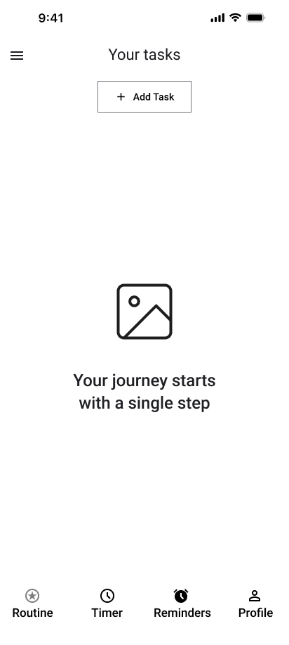
App
After logging in, the user will see their dashboard in the Routine section.
For now it is empty and a message will appear encouraging the user to add some tasks to his routine

Slide 9
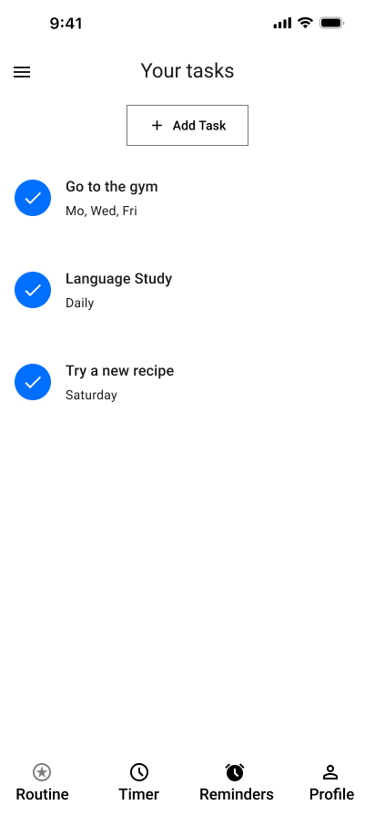
App #2
Here is what it looks like after you have created some tasks

Slide 10
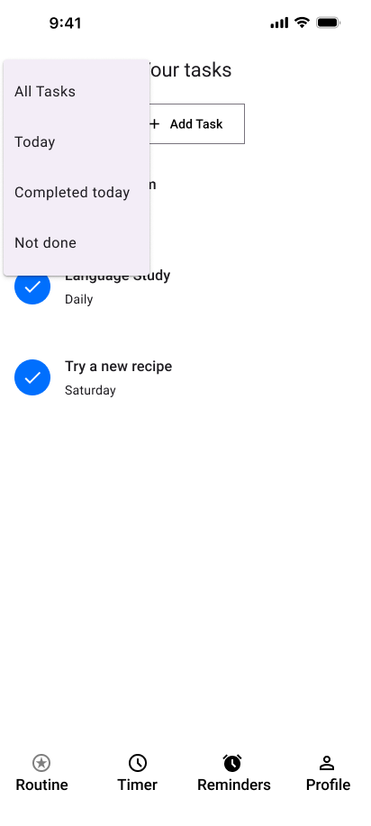
App #3
You can use the top button to sort through your tasks so you don’t have to dig through all of them once you start getting a couple more tasks

Slide 11
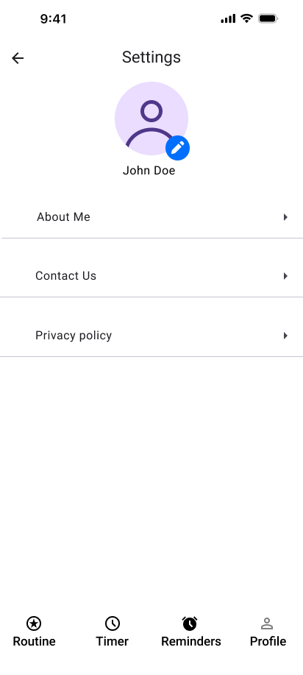
Settings
Under the Profile section you will find the name you have registered into the app, how to contact the company for any suggestions, advice or complaints

Slide 12
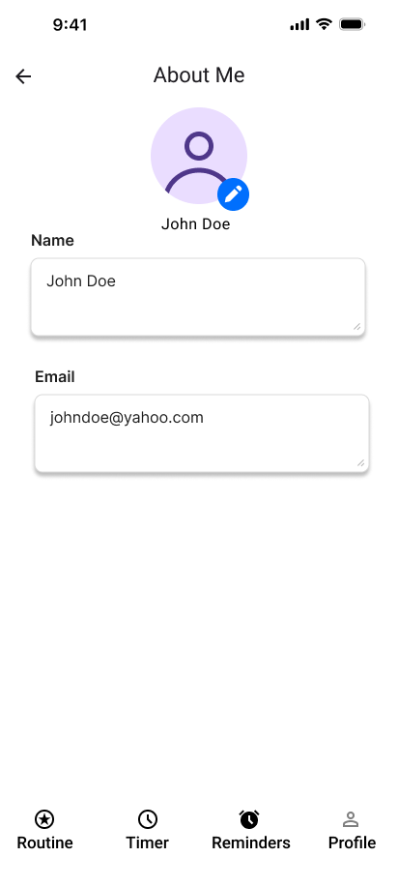
About me
When you enter the About Me part of the Profile, you will find your name and Email that you can change with confirmation from your new email

Slide 13
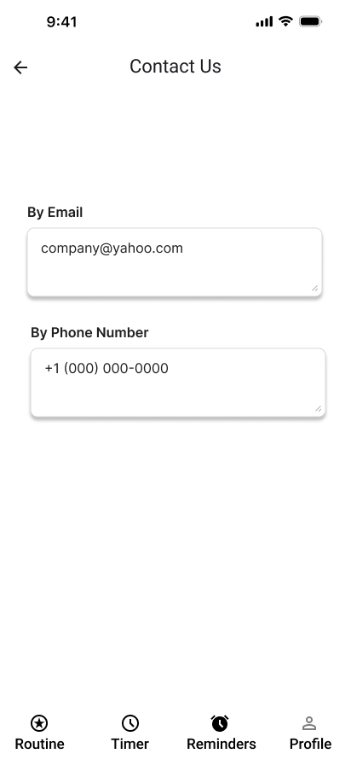
Contact Us
In the Contact Us section there is the contact information of the company

Slide 14
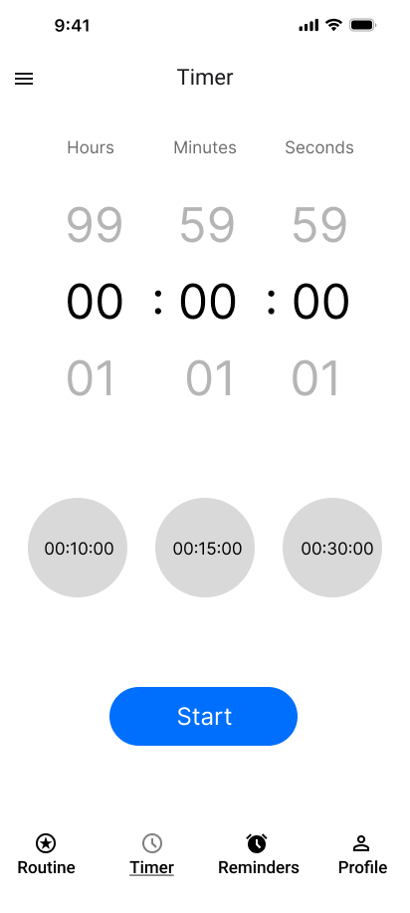
Timer
Going into the timer section lets you set a timer for how long you want to do your task, and it has three buttons for a quick timer.

Slide 15
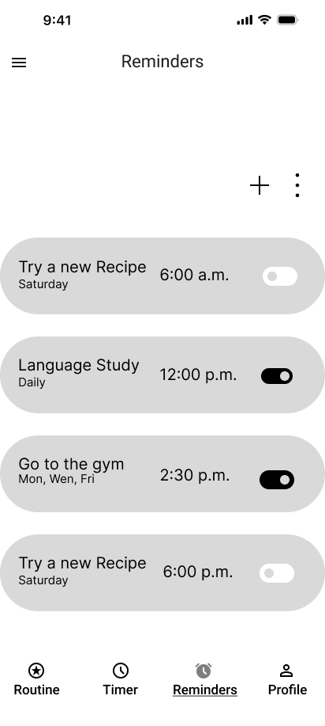
Reminders
Going into the Reminders section lets you set alarms for a task, so if you lose track of time an alarm will go off to remind you to do your task or if you can't do it that day for one reason or another you can turn off the reminder.

